Slide 1





MENTAL HEALTH MONITORING USING IOT AND MACHINE LEARNING
GROUP MEMBERS-KASTURI R. KAYARWAR,SEETHA SPANDANA, S.REVANTH

Slide 2





Table of Content
01
02
03
04
05
Abstract
Problem Statement
Objectives
Requirements
Methodology
06
07
08
09
10
Components/Connections
Output
Result Analysis
Future Scope
Conclusion

Slide 3







ABSTRACT
In an era where psychological well-being is as vital as physical health, the development of real-time mental health monitoring using the Internet of Things (IoT) holds transformative potential. This system integrates intelligent, non-invasive biosensors and data-driven algorithms to continuously assess stress, anxiety, and depression levels, enabling proactive mental health care.

Slide 4


Problem Statement
In recent years, there has been a significant rise in stress, anxiety, and depression among students and working professionals, primarily driven by academic, social, and occupational pressures. Traditional mental health assessment methods rely on self-reporting and infrequent clinical visits, often resulting in delayed diagnosis and intervention.
To address this critical issue, there is a pressing need for a continuous, non-invasive, and intelligent system that can monitor physiological and behavioral indicators of mental health. The proposed solution is a IoT-based system integrated with ML that collects real-time biometric data — such as heart rate, temperature, sleep patterns, and galvanic skin response (GSR) — to detect early signs of mental distress.

Slide 5



Objectives
To develop a device capable of capturing physiological signals relevant to mental health.
To implement ML models for real-time detection of stress and depressive symptoms based on HRV, GSR, and sleep patterns.
01
02
To build a cloud-based backend for secure data storage and AI inference.
A cost-effective, real-time mental health monitoring system that promotes self-awareness and enables early intervention for students and employees.
03
04

Slide 6
Requirements
Components
Software Requirements
|ESP32-Microcontroller unit for data acquisition and wireless communication
Pulse Sensor-Measures heart rate
MPU6050-6-axis accelerometer and gyroscope for motion/sleep analysis
DHT Sensor-Measures temperature and humidity
GSR Sensor-Measures skin conductance (Galvanic Skin Response)
Resistor (4.7kΩ)-Pull-up resistor for one-wire communication (DHT sensor)
Jumper Wires- For sensor-to-board connections
USB Port Cable-For ESP32 power and programming
Arduino IDE-Programming and uploading code to ESP32
Python 3.9+ -Backend processing and data analysis
Jupyter Notebook- Sensor data visualization, machine learning model training
Firebase-Cloud database for storing real-time sensor data
Flask (Python Framework)- Web server for API integration and dashboard interface
HTML - for user interface

Slide 7




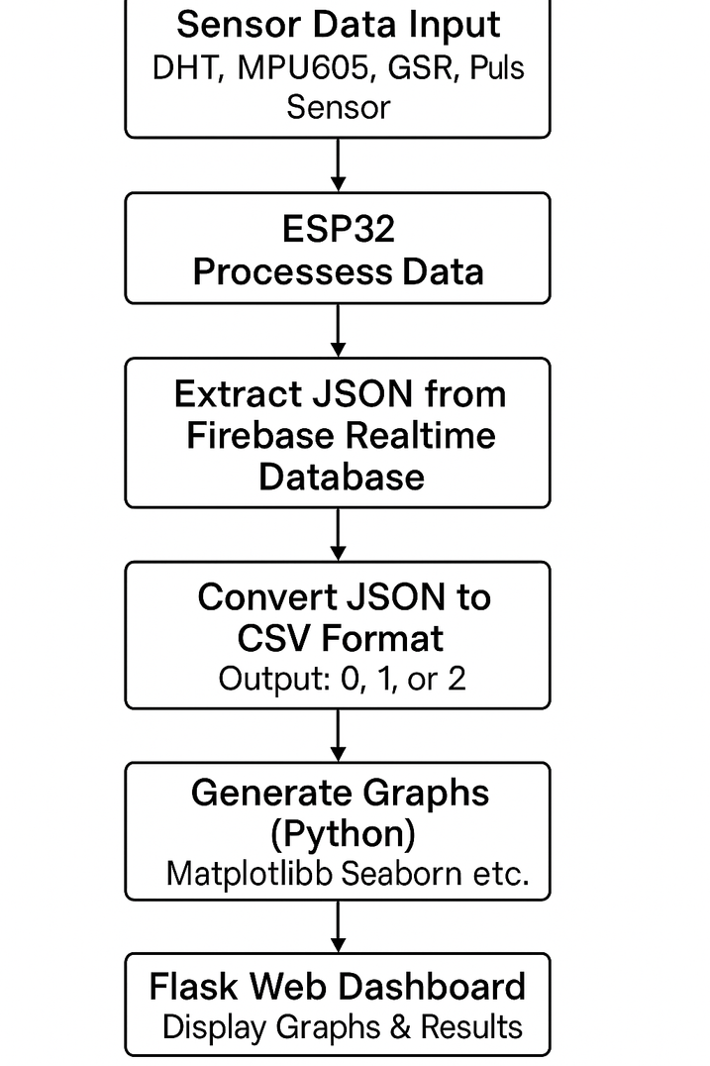
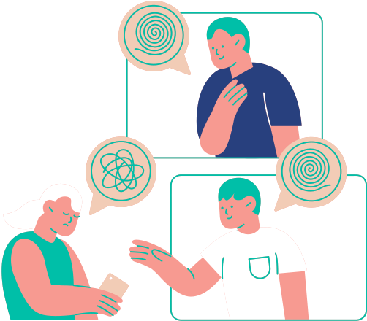
Methodology
The system monitors a user's physical and psychological well-being by integrating sensor data acquisition, cloud storage, machine learning analysis, and web-based visualization. The steps are as follows:
Sensor Data Collection
The ESP32 microcontroller collects real-time data from multiple sensors:
DHT11 for temperature and humidity
MPU6050 for motion and orientation
GSR sensor for skin conductance (stress levels)
Pulse sensor for heart rate
Data Transmission to Firebase
The collected sensor readings are transmitted via Wi-Fi to Firebase Realtime Database in JSON format.
JSON to CSV Conversion
On the backend (Python), the JSON data from Firebase is fetched and converted into CSV format for processing.

Slide 8
Methodology
Machine Learning Analysis
The CSV data is fed into a Random Forest Classifier which classifies each entry into one of three categories:
0 – Healthy 1 – At Risk 2 – Affected
Graphical Visualization
Classification Bargraph
Sensor Data Heatmap
Confusion Matrix
Bar Graphs for Each Sensor Field
Web Dashboard with Flask
A Flask web application displays the graphs, current health status, and historical trends to the end-user in an intuitive UI.
HTML Patient Lookup Feature
An additional HTML page allows users to search for a patient by name. When a name is entered:
The system fetches data specific to that patient (from Firebase or a CSV/DB).
Relevant charts are rendered dynamically.
Health status history and trends are shown for that individual.

Slide 9



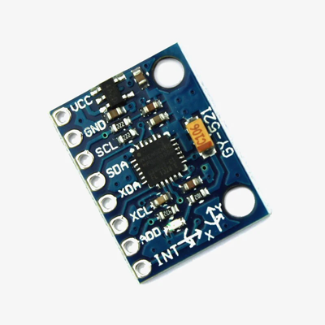
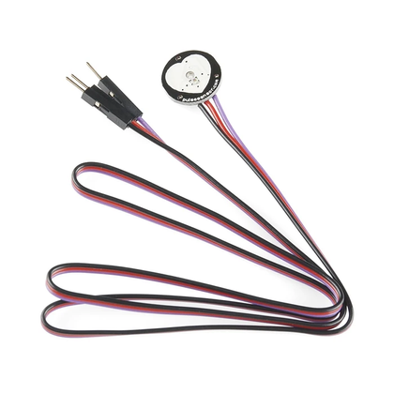
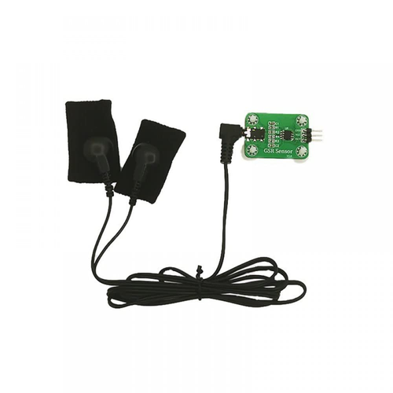
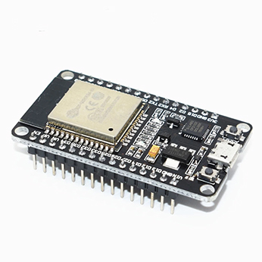
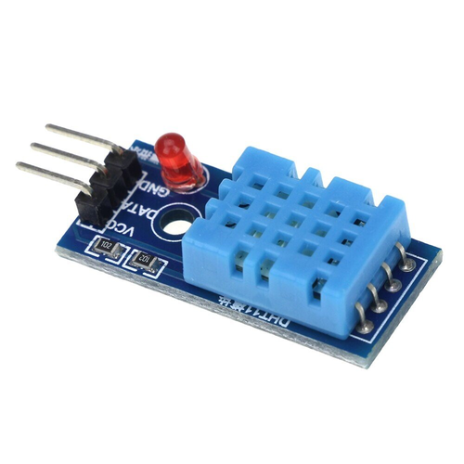
COMPONENTS AND CONNECTIONS
ESP32
MPU6050
PULSE SENSOR
GSR SENSOR
DHT 11

Slide 10
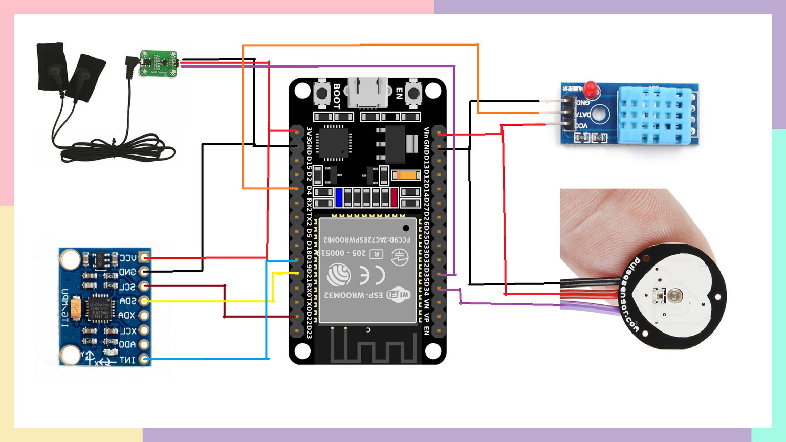
COMPONENTS AND CONNECTIONS
GSR SENSOR
VCC : 3v3
GND ; GND
DATAPIN : 35
DHT11
VCC : 3v3
GND ; GND
DATAPIN : 4
MPU6050
VCC : 3v3
GND : GND
SCL : 22
SDA : 21
INT : 19
PULSE SENSOR
VCC : 3v3
GND ; GND
DATAPIN : 34

Slide 11

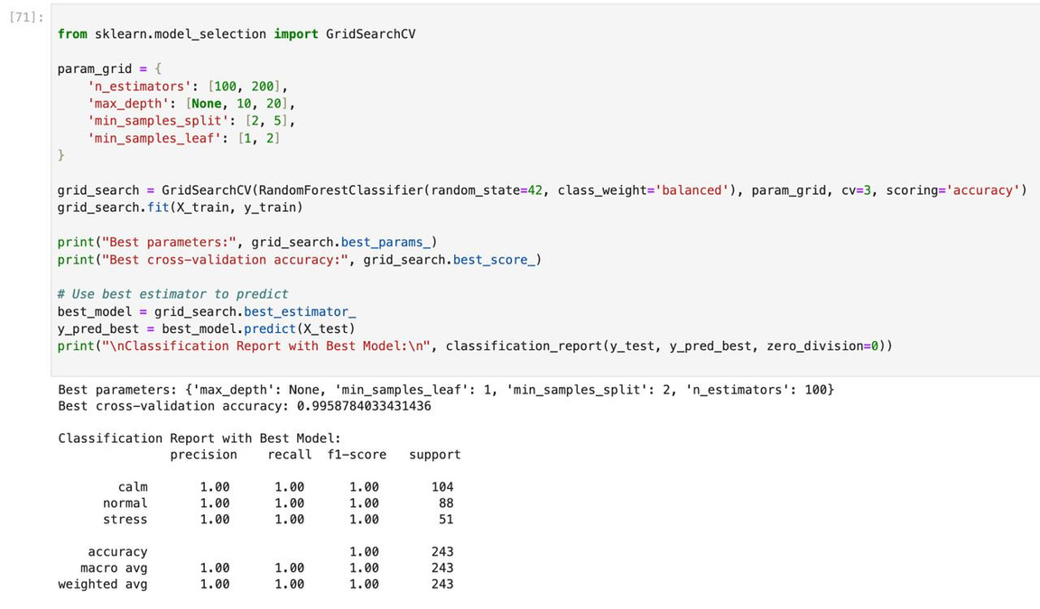
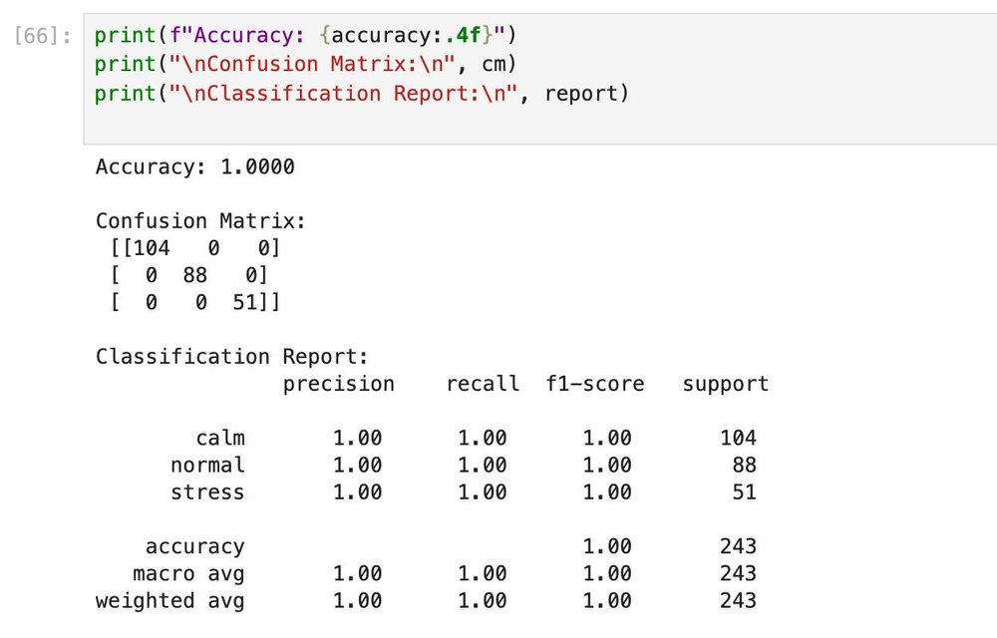

OUTPUT
MODEL ACCURACY
CROSS VALIDATION ACCURACY

Slide 12

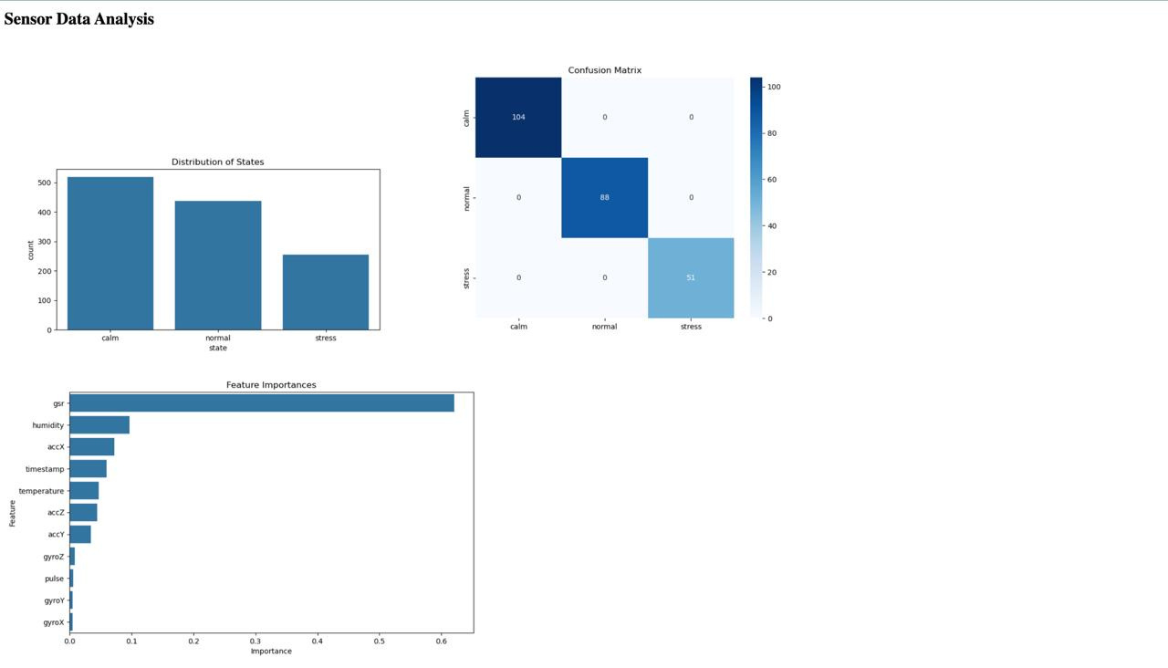

RESULT ANALYSIS
FLASK
The model accurately classifies mental states—Calm, Normal, and Stress—with 100% test accuracy. GSR is the most influential feature, followed by humidity and accX. Calm states dominate the dataset. Visualizations confirm model reliability and highlight key physiological markers for mental health classification.

Slide 13
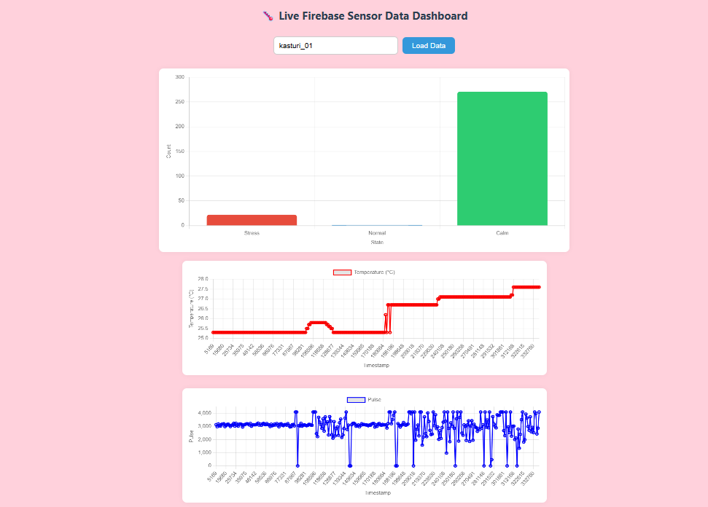
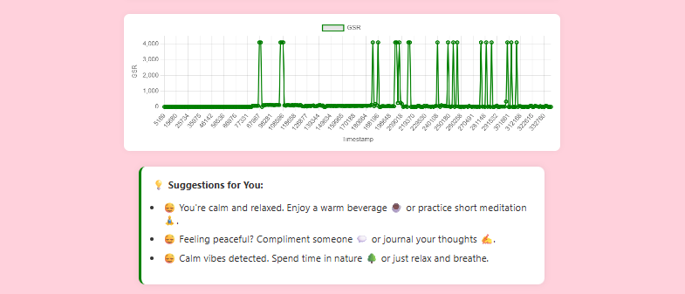
USER INTERFACE

Slide 14
FUTURE SCOPES
Integration with smart wearables (e.g., smartwatches) for real-time physiological data collection.
Use of AI/ML for advanced emotion recognition via facial expressions, voice, and text..
Remote therapy and tele-counseling through in-app chat or video call support.
Secure cloud storage for long-term mental health data and trend analysis.
AI-powered mental health chatbots for 24/7 support and self-assessment.
Anonymous peer-support communities to reduce isolation and stigma.

Slide 15

CONCLUSION
Overall, this IoT-ML-based system offers a scalable, low-cost, and intelligent approach to early detection and continuous monitoring of mental health conditions. It bridges the gap between raw sensor data and meaningful clinical insights, paving the way for preventive mental health care and timely intervention.

Slide 16


Thank You!

